Slide 1
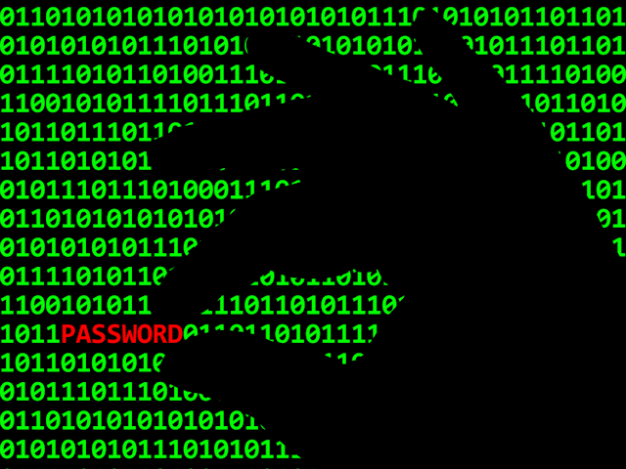
Password Pwning

Slide 2
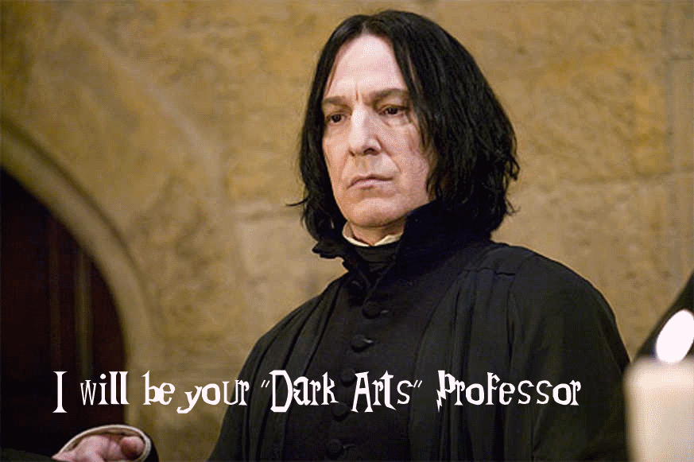

Slide 3
Who is this person standing in the front of the room talking?
PRIOR TO 2005
  Many years in IT
2005 - Present
  PAM, SIEM , DLP, Web App Pentesting , Wireless Network Pentesting, Physical Site Security Assessments , Lock Picking, Vulnerability Management, Computer Forensics

Slide 4


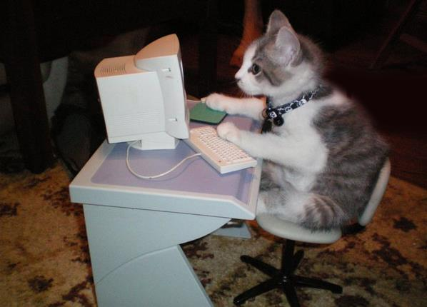

What does a hacker look like?
Look around you, anyone in the room could be a hacker!

Slide 5
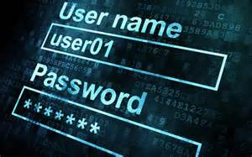
What makes a good password?
AaBbCc
12345
@!$%#^&*
>= 8 characters in length

Slide 6
What NOT to do with your password
SHARE IT!
Not used more than 1 place/site
Leave it laying around

Slide 7
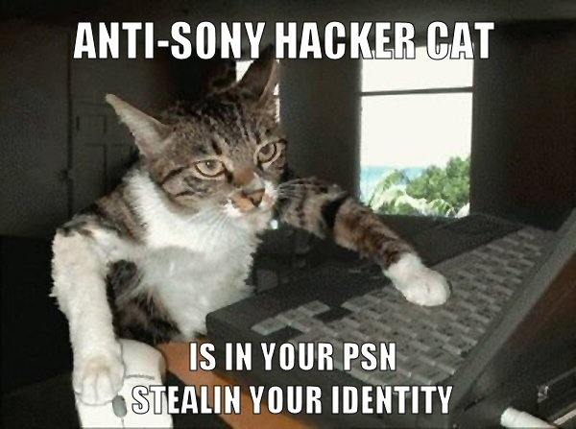

Slide 8
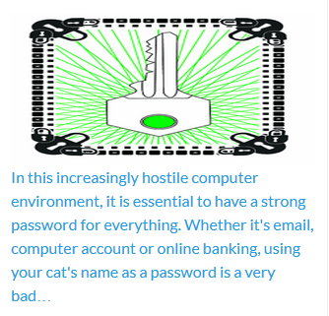

Slide 9

Questions and Answers

Slide 10
You know what it takes to create a good password, now what?
It is time to create your own password and test it!

